Slide 1
Many Cultures Meet
Chapter 1

Slide 2
The American Indians
Section 1

Slide 3
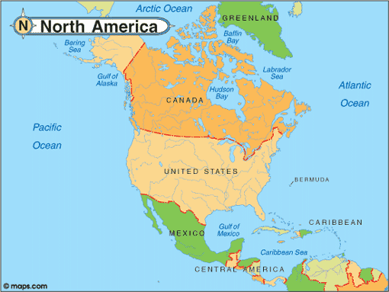

Slide 4
People Come to America (2 Theories)
Ice Bridges
Boats
15k years ago the oceans were frozen (ICE AGE)
People walked from Alaska to America
Searched for food
People arrived by boats 40k years ago
Arrived in present day CANADA and moved south to South America

Slide 5
Indians Adapt to Climate
12k years ago the ICE AGE ends; the planet melts
Food begins to grow
People can now hunt and gather food
Leads to people moving around America

Slide 6
Diverse Cultures emerge
As Indians spread out they develop different cultures
By 1492 Indians speak 375 languages
Divided into TRIBES
Each had CHIEF (leader)

Slide 7
Culture
What language(s) do you speak?
What religion are you? If any.
What is your ETHNICITY?
What foods do you like?
What are 3 holidays you celebrate?

Slide 8

Beginning of Agriculture (farming)
3.5k years ago in Mexico corn, squash and beans are planted
Technology spreads Northward to current U.S
People learned warmer climates could harvest more plants

Slide 9
Great Plains
Grassland in North America (Canada, U.S and Mexico)
Animals moved here to graze on grass
20 million bison
People hunted here instead of farming

Slide 10
Eastern Woodlands
Hills and low mountains (present day North and South Carolina
Mild winter / warm summer
Wet
Climate made FARMING easy (sun and water)

Slide 11
Section 1 Review:
1. What were the 2 THEORIES how people moved to America?
2. What ended 12k years ago?
3. What were NATIVE people divided into? What was their leader called?
4. How did the EASTERN WOODLAND people generally get food? Explain.

Slide 12
The Europeans
Section 2

Slide 13
Type 1 Writing
Write until you fill 2 lines
If there was a contagious disease that had no cure and was killing 100’s of people a day would you still come to school?
Why or why not?

Slide 14
Bubonic Plague (Black Death 1347)
Population is recovering from the BLACK DEATH
Killed 1/3 of all Europeans (33%)
Infection, not a virus
Infected Flea that jumped from person to person
Most lived in countryside bc those in cities had contracted the disease

Slide 15
Plague
Symptoms begin a few days after exposure to the flea bite or an infected humans cough
High fever, bloody cough, gangrene in fingers and toe, black bumps (buboes) across the body
Death rate was 70% or greater
Today is treated with ANTIBIOTICS

Slide 16
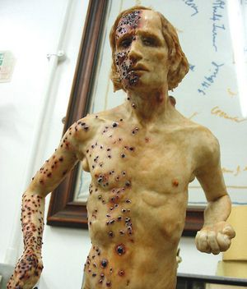

Slide 17
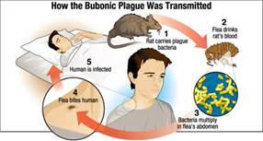

Slide 18
Unequal Wealth (Classes)
5% of people own ALL the land
Aristocrats: wealthy and owned land
2. Merchants: less wealthy; traded goods
3. Commoners: working poor; farmers
4. Beggars: unemployed

Slide 19
The Crusades
European Christians vs. Asian Muslims over RELIGION
Goal: Capture the Holy Land of Jerusalem where Jesus Christ lived
End: Muslims win; control the Holy Land

Slide 20
New Trade Routes
Europeans were jealous of Muslim technology, power and wealth
Muslim empire stretched from N. Africa to Asia
Road was extremely secure
Europeans wanted access to these routes

Slide 21
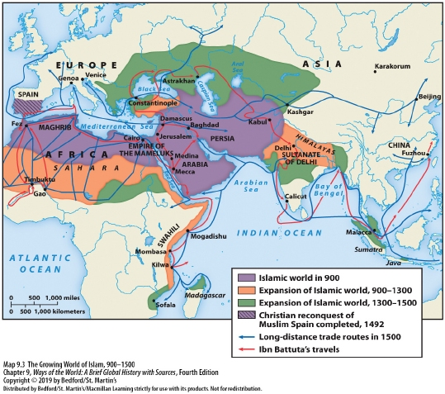

Slide 22

Portuguese Begin to Explore
Portugal is located next to the Atlantic Ocean
COMPASS allows them to determine direction of sailing
Prince Henry the Navigator (1419) sails south to Africa for the Muslims gold and ivory

Slide 23
Section 2 Review:
1. Describe the Bubonic Plague.
2. List, in order, the 4 classes of wealth.
3. What were the Crusades? The outcome?
4. Which Portuguese sailor went SOUTH to Africa?

Slide 24
West Africans
Section 3

Slide 25
Type 1 Writing
Write until you finish 2 lines.
If you were forced to live in a desert or a frozen tundra which would you choose?
Why?

Slide 26
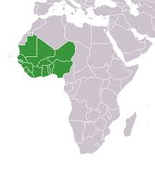
West Africa

Slide 27

Geography and Trade
Africa is made up of a diverse landscape (desert and grassland)
Contains valuable resources: Gold and salt
Africa was once an ocean that had dried up
West Africans became rich of trading these to Europeans

Slide 28
Ghana
Mali
1st African kingdom (300A.D)
Supplied gold to traders
Made the king very rich
Ghana is attacked (1200A.D) and becomes MALI
MANSA MUSA most famous king
Spread ISLAM throughout the continent

Slide 29
Religion
Most believe in ISLAM
Monotheistic: 1 God
Or:
Believed in spirits (rain, trees, earth, sun)
Polytheistic: many gods

Slide 30
Economy
Land did NOT belong to people
It belonged to Kings (Gods)
They assigned land to families / told what to grow
Worked to stay on the land

Slide 31

Slavery (in Africa)
Common in West Africa
People were traded for gold, ivory or guns
Slaves were people that were captured in war or criminals
However; became part of new families / children were free
Some became wealthy

Slide 32
Slave Trade Begins
West African kings created trading posts along the coast
Portuguese would stop here for gold and people
By 1500 over 1,800 slaves were purchased

Slide 33
Section 3 Review:
1. What 2 resources did West Africans trade at 1st to become wealthy?
2. Compare MONOTHEISM and POLYTHEISM?
3. Describe the ECONOMY of Africa. (2 facts)
4. Which COUNTRY was the 1st buyers of SLAVES outside of Africa?

Slide 34
1st Encounter / Spanish & Portuguese Explorers
Section 4

Slide 35
Vasco Da Gama
Sails around Africa to India
1st European to reach INDIA by sea
Opens trade routes to Asia
Trade routes are very profitable for Portugal

Slide 36
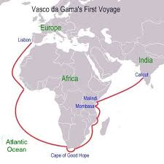

Slide 37

Christopher Columbus
Italian who sailed for Spain
Was looking for a quicker route to China
Sails West instead of East
Believed Earth was ROUND and not flat

Slide 38
Columbus’s Journey
1492 3 ships (Nina, Pinta, Santa Maria (largest)
After 33 days reaches the Bahamas
Believed he landed in India; this is why Natives are called INDIANS to this day
1st European to ENCOUNTER America

Slide 39
Spain and Portugal Divide America
Treaty of Tordesilla 1494
Splits the New World in ½ between a North South line
Portugal got present day Brazil
Other European countries did not honor this treaty

Slide 40
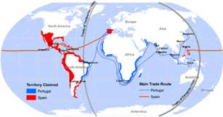
Treaty of Tordesilla

Slide 41
Amerigo Vespucci
Mapmaker; draws map of east American coast
Other sailors began calling the New World “AMERICA” in their own maps
America is named after him
Wasn’t sure how big America actually was

Slide 42
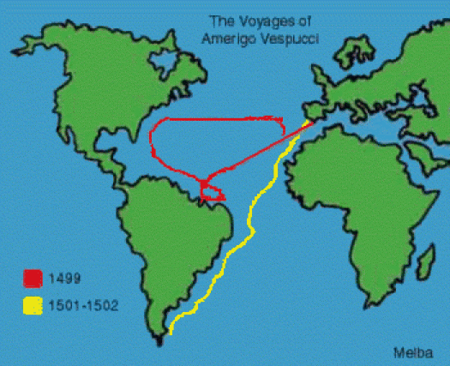

Slide 43

Ferdinand Magellan
Spanish explorer and 1st PERSON to circumnavigate (circle) the world
Dies in a conflict with NATIVES about 75% of the way around the world

Slide 44
Hernan Cortez (Conquistadors)
Conquered the Aztecs (Present day Mexico)
Richest city in America
Over 200k people
Filled with gold and silver

Slide 45
Francisco Pizarro
Conquers the Inca’s of Peru
He had only 180 soldiers
Superior weapons such as; steel swords and crossbows
NATIVES used stone weapons

Slide 46

Disease
Hispaniola (island) pop. Decrease from 300k to 500
Diseases included;
1. Smallpox (red pox from infection)
2. Typhus (fever from parasite)
3. Diptheria (swollen throat from bacteria)
4. Cholera (diarrhea from bacteria)
Natives had no immunity built up against them

Slide 47
Section 4 Review:
1. What was Columbus looking for? Which way did he sail?
2. List and identify 2 of the Spanish explorers.
3. Who did Cortez conquer? Pizarro?
4. List and describe 2 of the diseases that killed many natives.

